Slide 1
Digital Portfolio
STUDENT NAME: A.Nazema
REGISTER NO AND NMID: astvu30430424u09017/394359.
DEPARTMENT: Bachelor of computer Application
COLLEGE:AAA college -walajapet/Thiruvalluvar University.

Slide 2
PROJECT TITLE

Slide 3


AGENDA
Problem Statement
Project Overview
End Users
Tools and Technologies
Portfolio design and Layout
Features and Functionality
Results and Screenshots
Conclusion
Github Link
3/21/2024 Annual Review

Slide 4

PROBLEM STATEMENT

Slide 5

PROJECT OVERVIEW

Slide 6

WHO ARE THE END USERS?

Slide 7

TOOLS AND TECHNIQUES

Slide 8
POTFOLIO DESIGN AND LAYOUT
8

Slide 9
FEATURES AND FUNCTIONALITY

Slide 10
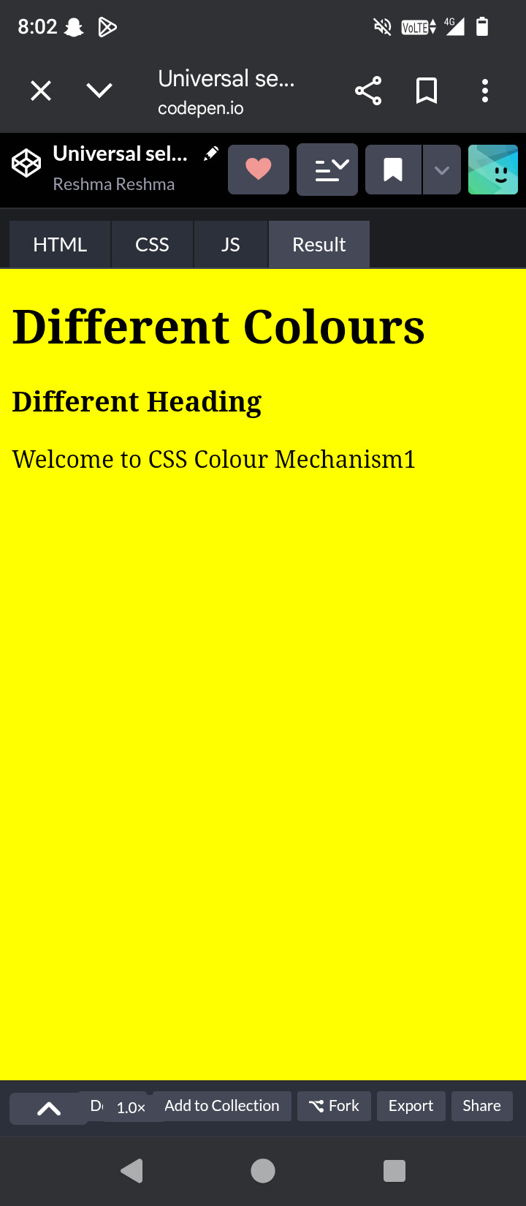
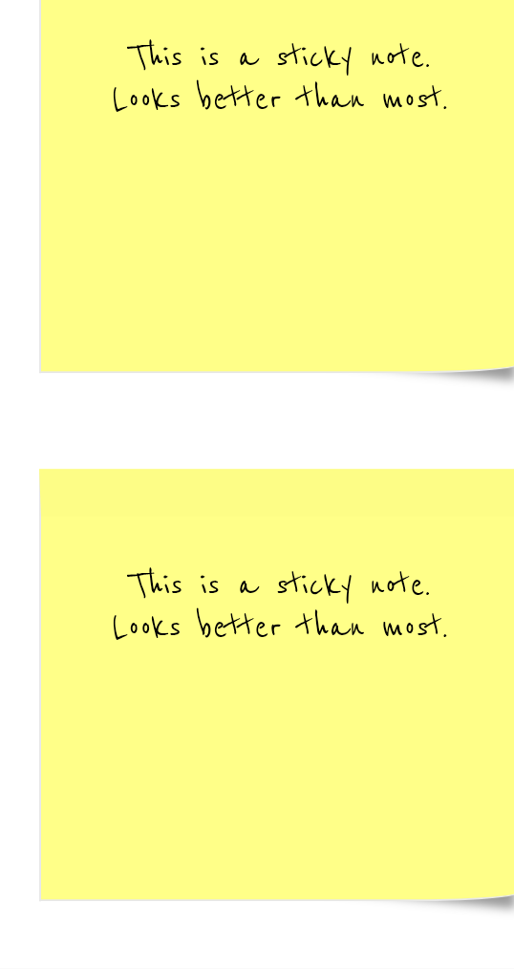
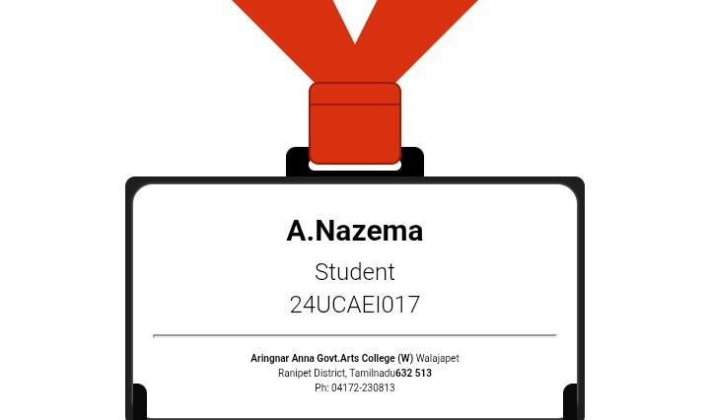

RESULTS AND SCREENSHOTS
3/21/2024 Annual Review
10

Slide 11
CONCLUSION
11

